Slide 1
Introduction to Node.js for the SharePoint & Office 365 Developer
Andrew Connell
@andrewconnell | www.andrewconnell.com
github.com/andrewconnell/pres-o365-node

Slide 2
Topics
What is Node.js? … and io.js?
Developer Tooling for Node.js
Creating Websites & Web APIs with Node.js
Developing with Node.js
Node for Office & SharePoint Add-ins

Slide 3
1
Mention Our Sponsors
There are 4 slides to show, but they make today possible

Slide 4









Please thank our sponsors!
Platinum Sponsors

Slide 5






Please thank our sponsors!
Gold Sponsors

Slide 6

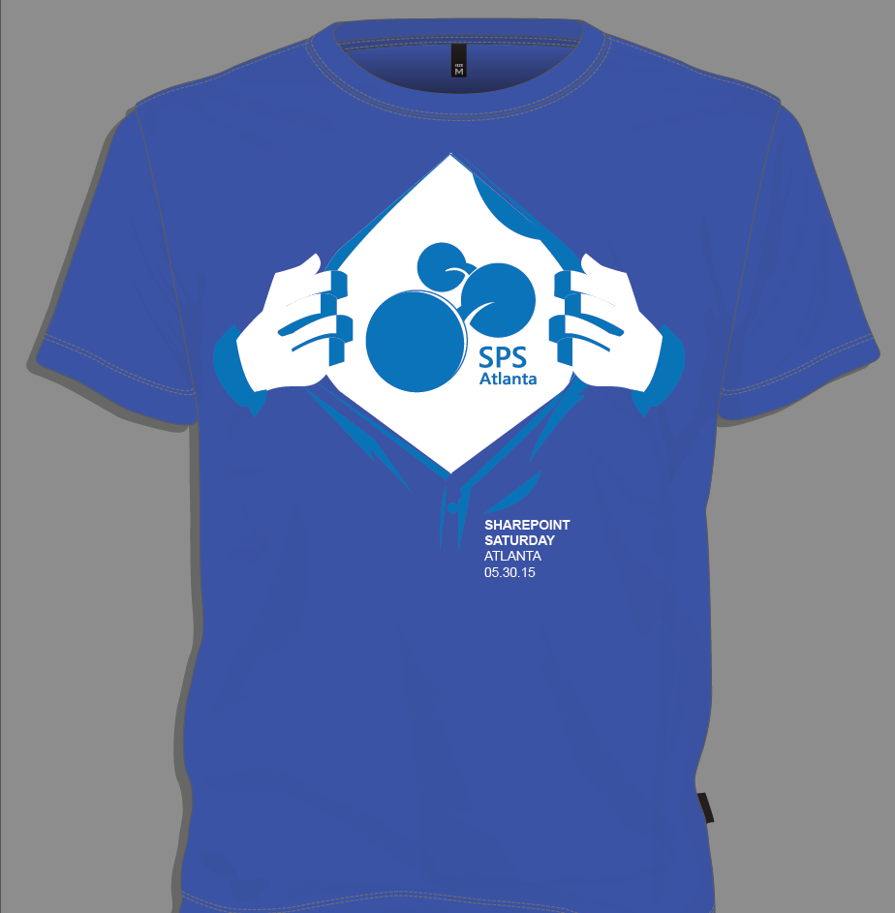
Attendee Shirts
Speaker Shirts

Slide 7
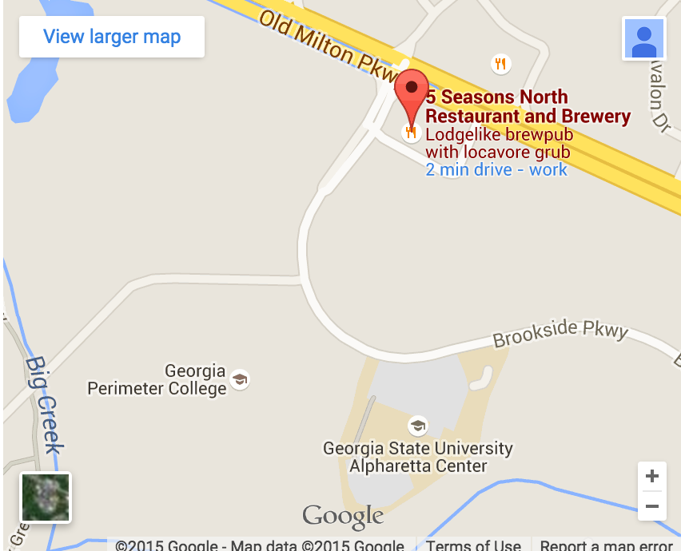
Join us for SharePint sponsored by
5 Seasons Brewery (North)
Right after the event ends
The parking is located directly in front of brewery
See the SPSATL Website for more info and directions

Slide 8
What is Node.js?

Slide 9
What is Node.js
Cross platform environment for hosting JavaScript
Facilitates end-to-end JavaScript environment
Ideal for network & I/O based applications
Non-blocking, event driven
Open source
Managed by
Node.js Foundation
Joyent
https://nodejs.org

Slide 10
Who uses Node.js?
Microsoft Azure - http://aconn.me/1HZWEl2
Yammer - http://aconn.me/1Gxy9hL
Walmart - http://aconn.me/1HZWz0w
PayPal - http://aconn.me/1DsFZqx
LinkedIn - http://aconn.me/1NZNs1S
Trello - http://aconn.me/1OjCPsI

Slide 11
Node.js Components
Node
NPM
V8

Slide 12
Node.js vs io.js
Node.js – https://nodejs.org
Managed by Node.js Foundation (+Joyent)
Current (v0.12.2) uses V8 v3.28.73
io.js - https://iojs.org
Forked copy of Node.js in late 2014
Created out of community frustrations with decline in the pace of contributions & releases - http://aconn.me/1NZQvHl
Current version (v2.0.0) uses V8 v4.2
Contains many fixes & features not yet implemented in Node.js
Compatible with NPM
What will the future hold?
https://github.com/nodejs/dev-policy

Slide 13
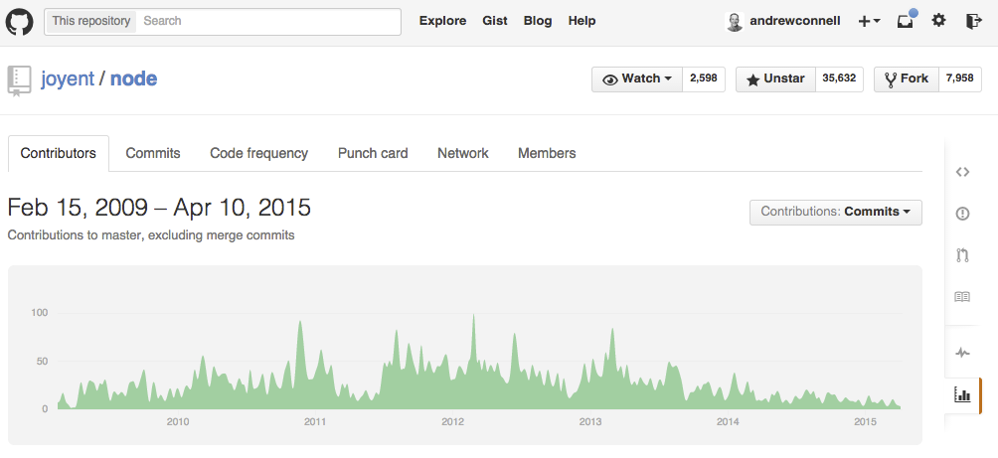
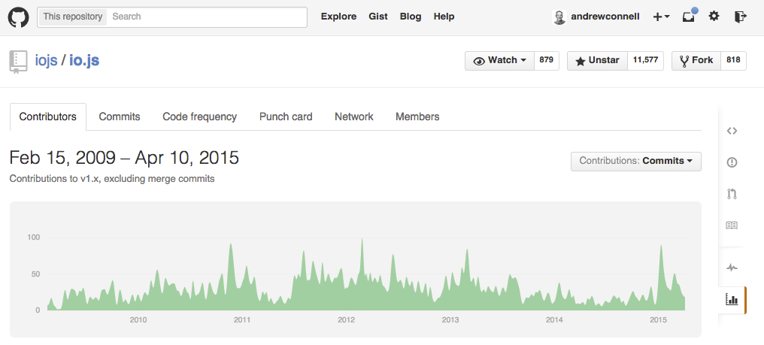

Slide 14
Appeal of Node.js & io.js
One language used from server to client
Same language used in projects & ecosystem around the projects
Build process
Developer tooling
System configuration
Cross platform
Built for network & I/O bound operations

Slide 15
Developer Tooling for Node.js

Slide 16
Node.js Developer Tooling Options
Visual Studio
https://www.visualstudio.com/en-us/explore/node-js-vs
Visual Studio Code
https://code.visualstudio.com
WebMatrix
http://www.microsoft.com/web/webmatrix
WebStorm
https://www.jetbrains.com/webstorm
Brackets
http://brackets.io
Any text editor

Slide 17
Developing Node.js

Slide 18
Node.js for Websites & Web APIs
Connect
Express
MVC
APIs

Slide 19
Express
Minimalist web framework
Built on Connect
Unopionated
Developers write all the plumbing code
Extensible – multiple MVC framework options

Slide 20
MVC Frameworks in Node.js
Jade
Unique HTML shorthand syntax
EJS
Embedded JavaScript
Vash
Similar to ASP.NET’s Razor syntax
Handlebars
Same as client-side syntax

Slide 21
Debugging Node.js Applications
Node --debug
node-inspector
Nodemon
spy.js

Slide 22

Thanks! Questions?
Andrew Connell
@andrewconnell | www.andrewconnell.com
github.com/andrewconnell/pres-o365-node

